Slide 1
Behavior Based Safety: The answer to your safety culture or a load of BBS?
Jon Birkes, MS, CSP
Lake County Safety Council
05/17/2019

Slide 2
Introduction
Jon Birkes, MS, CSP
> 13 years in Safety, Health, Environmental Field
Academia – Facility Safety, Laboratory Safety, Biosafety, Radiation Safety, Construction Safety
Chemical Additive R&D / Plastic Extrusion / PSM Pilot Plant
Adhesives Manufacturing
Notes:
1 Minutes – Talk about your self
Jones Lang Lasalle – SafeStart
Henkel – Safe and Unsafe Acts (SUSA)

Slide 3
Today’s Takeaways
Understand the psychology behind Behavior Based Safety (BBS) programs.
Determine if your company is ready for BBS.
Avoid common mistakes made with BBS.
Identify/Develop a BBS program that works for your team.
Notes:
1 minute

Slide 4
What is BBS?
Behavior Based Safety – What do you think? What have your heard? Who has a program?
The use of applied behavior analysis models to achieve continuous improvement in safety performance.
Observe-> Document -> Reinforce -> Track -> Trend
Notes:
What do you think of when you hear behavior based safety programs? 3 mins
This explains it right?
Observe an employees behavior
Document was the employee safe or unsafe, following rules or not following rules
Reinforce the correct behavior
Track your results in some type of database or data collection
Trend to the data to look for reoccurring issues

Slide 5
Is BBS effective?
Petroleum Refinery – 21 year study showed 81% decrease in recordable incidents, 79% decrease in lost-time incidents, 97% reduction in worker’s compensation cost.
EuroKera (ceramic glass) – Three years after starting a BBS program; Recordable rate from 24.2 to 4.2, Lost time rate 2.69 to 0 for a 500 employee facility.
Offshore Oil Platforms – 150 sites saw a 55 % reduction in workers compensation cost after 5 years.
Notes:
2 minutes
Here are three examples of where an EFFECTIVE BBS program worked for a company.
If done well, these programs work, but these programs need to be implemented carefully and deliberately
As you can, you can see some progress quickly, but depending on implementation it can take years to see some results.

Slide 6
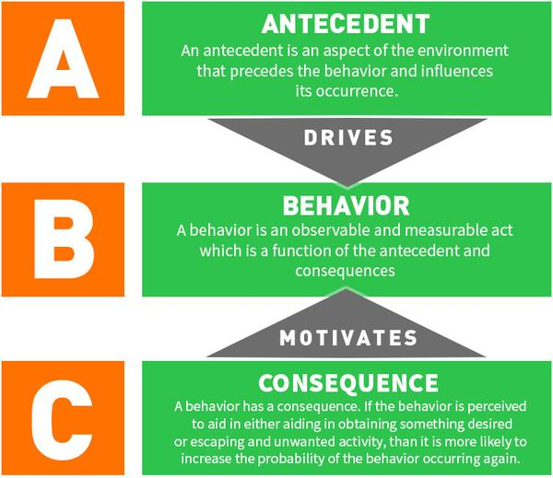
Basis for BBS
Notes:
In Applied Behavior Analysis, the antecedent, behavior, and consequence are considered considered "building blocks" in understanding, analyzing, and potentially changing how one acts
This model is used in schools, animal training, and can be applied in multiple facets of the workplace
These are the basis for driving behavior change.
Antecedents - Drive that behavior to occur.
Behavior – What the person does
Consequences – Reaction to the behavior

Slide 7
Antecedent (Trigger)
Antecedents are preexisting sensory or intellectual input that trigger behaviors and influence decision making – Thomas Krause
Immediate
Told to begin/stop a task
Non preferred personnel giving directives
Being told “no”
Slow
Court dates
Medication
Sleep schedule
Family concerns
Notes:
These are the things that occur trigger behaviors to occur. Can you think of some antecedents or “triggers” at work or at home?
• Tell us what to do to receive a consequence
• Can be tangible/concrete or intangible/abstract
• Only as powerful as the consequences that support them

Slide 8

Behavior
Acts or actions by individual that can be observed by others – E. Scott Geller
What we do and say, not what we think, feel, or believe.
Notes:
• Must be observable, measurable
With regards to BBS, the expected behavior must be pretty black/white
Seat belts on PITs, Chemical gloves when working with solvents, safety glasses on production floor
• Any time, any where, any body

Slide 9
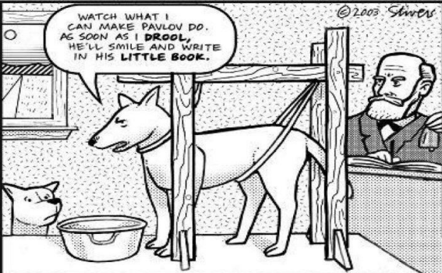
Consequence (Response)
What happens to people as a result of their behavior – Aubrey Daniels
  Positive or Negative
  Immediate or future
  Certain or uncertain

Slide 10
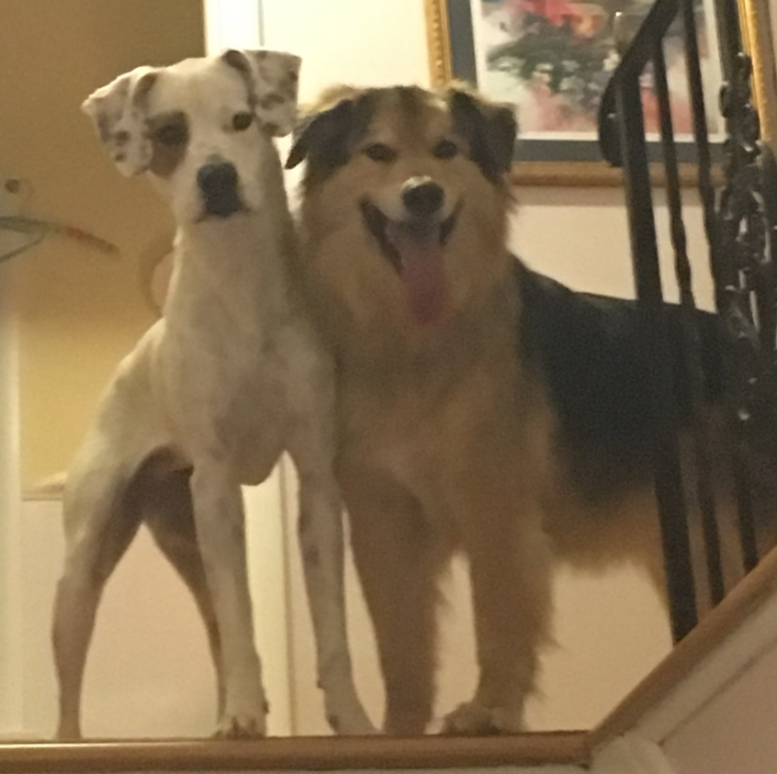
Consequences (Response)
Mickey (13) –
  Pinch Collar/Shock Collar Training
    Positive Punishment
Nellie (3) –
  Clicker Training
    Positive Reward
Notes:
Mickey was trained with Positive Punishment – Using pinch/collar when performing unwanted behaviors to reduce behavior.
Nellie is being training with Positive Reward – Giving treats to reward wanted behaviors and increase wanted behaviors.
Stimulus must occur as close as possible to the behavior (Rubbing nose in pee on floor not going to be effective).
Dogs, timing must be close in order to be effective. People can have delayed reinforcement, but reinforcement is always much more effective when it is close to the timing of the behavior.

Slide 11
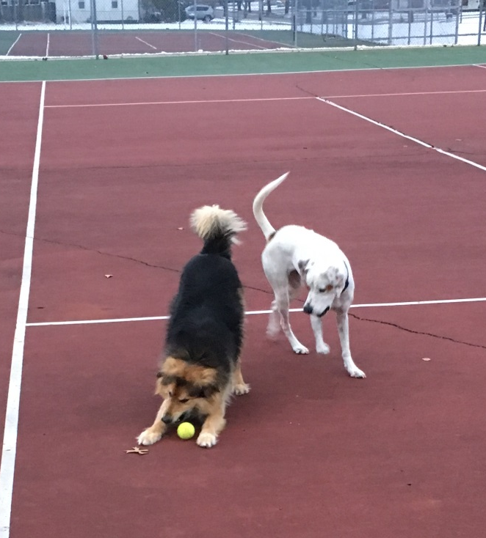
Consequences (Response)
Why they do inappropriate things (i.e. unsafe acts)?
Immediately certain positive reinforcement (save time, save effort, less discomfort)
Notes:
Need to overcome this input and make behaving properly (i.e. working safely) a much more valuable input than the daily input of cutting corners.
Any questions about the scientific basis of BBS?

Slide 12
Are you ready for BBS?
Measurement
Accountability
Positive Culture
Upper Management Support
Basic Safety Programs
Notes:
Now we are going to talk about what you need in place in order to ensure that your BBS program will work.
For many of you, you may not be ready.
Better to delay roll out, than to fail.
Talk about failure at Adhesives Plant
If you look at your company and you do not have all of these in place, your BBS program will have a very difficult time getting off the ground.

Slide 13
House of BBS - Foundation
Management support
  Supervisor, managers, and executives take responsibility for safety
    Safety is the job of operations (line management) not the safety manager or committee.
  Time away from production line
    Training, completing surveys, entering surveys, attending committee meetings, maintenance to repair, etc, etc.
  Funds and the ability to spend them where appropriate
Notes:
Upper management support is absolutely necessary in order to ensure these programs get off the ground. If there is even an inkling that it will not be supported, slow down.

Slide 14
House of BBS - Foundation
Basic safety programs
  OSHA Compliance, Training programs, Accident investigation, Hazard identification.
  Front line personnel cannot observe safe/unsafe behavior if they don’t know what is safe/unsafe.

Slide 15
House of BBS – Living Space
Positive Culture
  Trust, Openness,
  Respect for Individuals,
  Positive reinforcement

Slide 16

House of BBS – Living Space
Culture
Visible
  Behavior
  Attitudes
  Values
  Beliefs
Invisible
Notes:
Attitudes values and beliefs impact our behavior and unless we get a change we will not achieve a shift in culture!

Slide 17
House of BBS – Roof
Measurement –
  Are safety metrics part of you top level KPIs?
    NOT just recordable and lost days
      # of observations, quality of observations, # action items created from observations, closure of action items in timely manner.
  Are there goals surrounding these metrics
    100% completion of training, Corrective actions completed within 90 days, inspections completed by 3rd Friday of the month

Slide 18
House of BBS – Roof
Accountability –
  Meeting these goals apart of everyone’s expectations?
  Do you have a “Cadence of Accountability”
    Meet frequently to ensure that goals are being met.
    Must be from top down and back up again
  Is the program doing what it is meant to?
    Check and adjust

Slide 19
Common Mistakes
BBS will solve all my problems
Manger/Supervisor not participating
Roll-out needs to be well-supported, timed, and completed.
Observations too complicated
Used as “got ya” moment.
  Not enough positive reinforcement
Notes:
BBS needs to be one tool in your tool box, it can not be seen as the magic bullet that will save your safety program.
BBS is typically a “front line driven program”, but manager’s/supervisor must also be conducting observations so it is not viewed as “another task for the hourly employees.
Make sure your organization is ready for BBS. If immature safety management system and culture or other logistical or operational reasons exist, a successful outcome will be rare. False starts almost always create barriers to future attempts.
Observations should be limited to 5 minutes, 2-3 behaviors, integrated into job

Slide 20
Common Mistakes
Blaming the employee
Focusing on Meeting metrics, not reason of observation
Ignoring the data
Not celebrating wins
Stagnation
Notes:
DON’T WANT SAFETY COPS. Try to get more positive reinforcement activities to lead to lasting change. Focus on coaching, not discipline and punishment.
Employees generally do not want to put themselves at risk of an injury. Need to take a deeper dive into observations to understand why they acted the way then did.
Getting the numbers is not more valuable than the observation itself. Just having employees actively discussing safety topics on the floor is invaluable to the organization.
Use the data gathered in these observations to curtail training and future observations. If your observations are seeing that everyone is wearing safety glasses, don’t need to focus on this as much in the future (maybe occasional)

Slide 21




Behavior Based Programs
Off the shelf BBS Programs
DEKRA – Adaptive BBS
DuPont STOP (Safety Training Observation Program)
Safety Performance Solutions
Safe Start
TOPF Process
Notes:
Cookie cutter programs that can be implemented after some training
PROs
Already developed for you
Structure and training ready to implement
CONs
May not be what your organization needs
Can be like putting a square peg in a round hole.
EXPENSIVE

Slide 22
Behavior Based Programs
Homegrown BBS programs.
  Get management on board
  Pick your team to implement
  Develop your process
    What are you going to audit (Pick 6 safety critical items)
    How are you going to track (Use Excel)
    How are you going to use the data (Review data, have meetings and address the big issues)
  Train your team to perform audits
  Keep it going (Have games, get engagement, celebrate wins as a team)
Notes:
PROS
You can make it your own and fit it to your organization
Cheap
Cons
Lot of work to develop ground game, training, and roll out.

Slide 23
Recommended Podcasts
Safety FM with Dr. Jay Allen
  Focusing on BBS
Pre-Accident Investigations – Todd Conklin
  Focuses on Human and Organizational Performance (HOP)

Slide 24
References
Good overview of BBS: www.oshatrain.org/pdf/otn717w.pdf
How to Get More People Involved in Behavior-Based Safety: Selling an Effective Process. E. Scott Geller.
Behavior Analyses Help People Work Safer. American Psychological Association, February 2014
Behavoir Based Safety Guide. Health and Safety Authority. ISBN NO. 978-1-84496-175-7 HSA0392
Safety Culture 2018: Seven Life Lessons from E. Scott Geller. EHS Advisor. Emily Scace Sep 17, 2018 Safety Culture and Behavioral Safety
Effective application of behavioral based process in offshore operations. Spigner, J; Gaupreaux, G; Amanto, Frank. USDOT Publications . 2002. https://digitalcommons.unl.edu/cgi/viewcontent.cgi?article=1036&context=usdot

